Slide 1
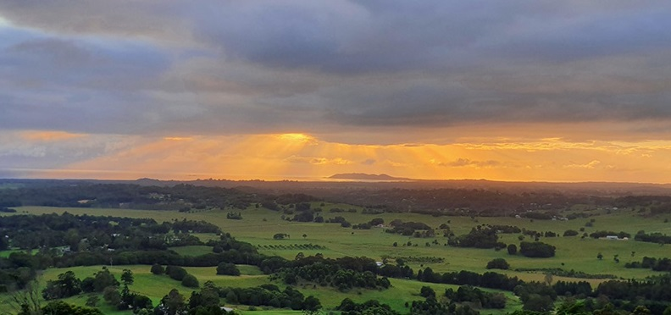
Week 6 Workshop:
Wellbeing in practice
INDG6002 Health and Indigenous Peoples
​

Slide 2
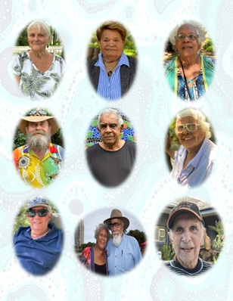
Gnibi Elders Principle that aligns with:
Wellbeing in practice
Principle 2: “Indigenous peoples are active, able and worthy peoples.”
Gnibi Elders Principle 2 reminds us that Aboriginal and Torres Strait Islander peoples are active, capable, and self-determining peoples whose strengths, knowledge, and leadership are central to health and wellbeing.
https://www.scu.edu.au/about/first-peoples/gnibi-elders-council/

Slide 3
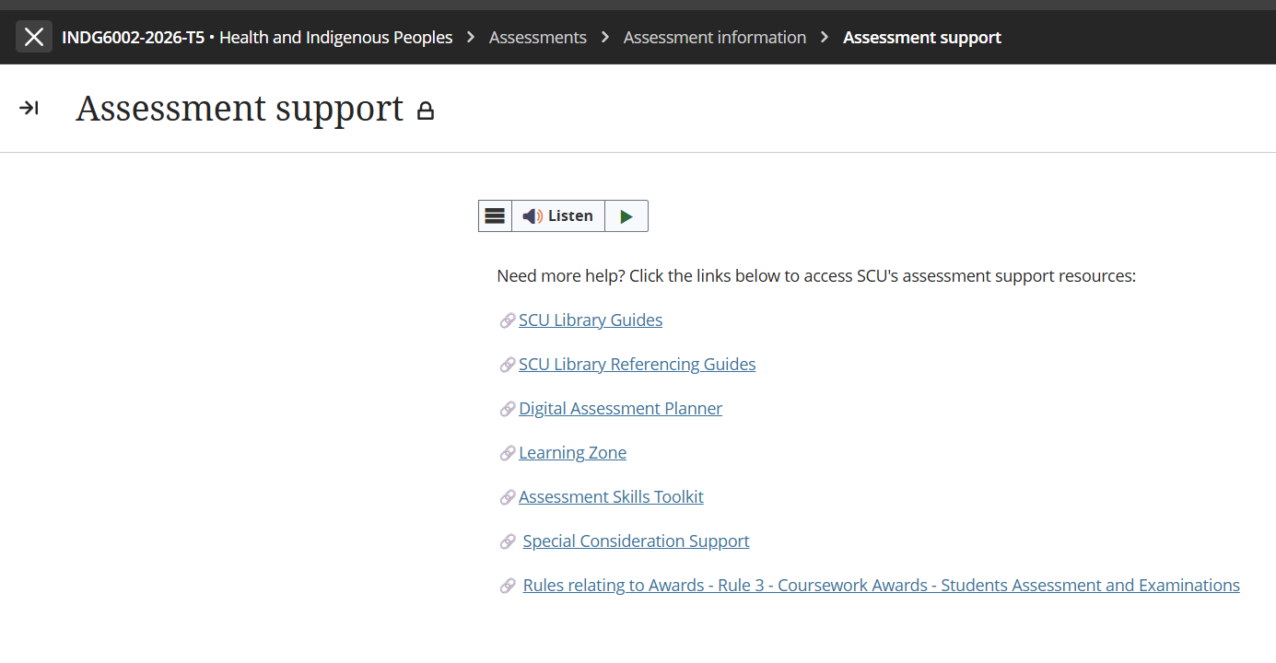
Special Considerations Support extension

Slide 4
Assessment 2 – Critical Review
Title | Assessment 2
Type | Critical Review
Length | 2,200 words
Weighting | 60%
Academic Integrity | Level 2. Purpose-Specific GenAI Use GenAI may NOT be used EXCEPT Grammarly Premium AI.
Submission | Word document submitted to Blackboard
Unit Learning Outcomes | This assessment task maps to the following ULOs: 1. Discuss key concepts of health and wellbeing as determined by Aboriginal people 2. Identify key stages of the colonisation process and its relationship to the contemporary health status of Australian Indigenous people 3. Analyse the relationship between socio-economic factors and the contemporary health status of Australian Indigenous people 4. Explain how primary health care and/or health promotion enhances the wellbeing of Indigenous people and role of the health professional as an agent of social change

Slide 5
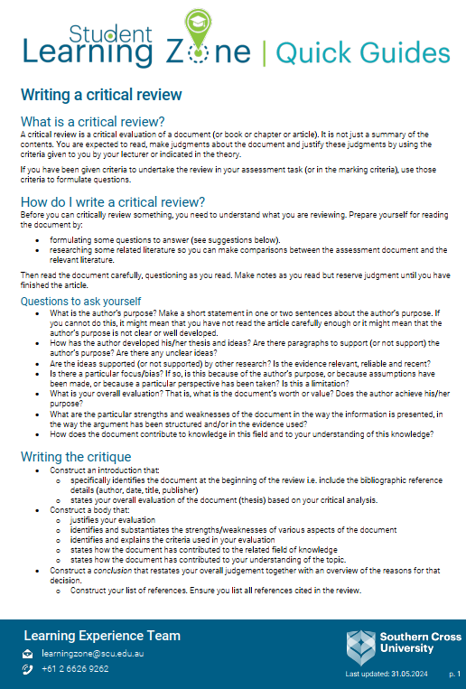
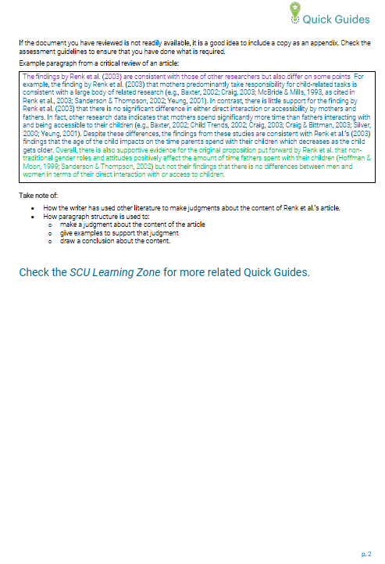
Writing a Critical Review
https://www.scu.edu.au/media/scu-dep/current-students/learning-zone/quick-guides/writing_a_critical_review.pdf

Slide 6
Critical Review of the Scenario
A critical review goes beyond description by examining why something happened, how it influences outcomes, and what it means in a broader context
In this assessment, you are not reviewing a written document—you are critically reviewing a scenario and practice interaction.
Instead of reading an article, you are examining:
  Sarah’s experiences
  The impacts of colonisation on her contemporary health
  the cultural context shaping the encounter
  the power dynamics in the consultation
  How primary health care and health promotion can respond

Slide 7
Critical Review of the Scenario continued …
Judge the strengths and weaknesses (of the actions and recommendations in the scenario) – which must be evidence-based
Identify bias or assumptions - Analyse privilege, whiteness, and Western norms (how these assumptions affect Sarah’s wellbeing and care)
Overall evaluation - Judgement about the quality of practice - Must be linked to theory
A critical review always ends with a judgement.

Slide 8
Assessment 2 – Brief
Rationale – Why this assessment matters
Apply unit concepts to a realistic health care scenario
Critically examine culturally safe, strengths‑based, socially responsive practice
Analyse:
  SEWB concepts
  Impacts of colonisation
  Socioeconomic determinants
  Primary health care & health promotion
Shift away from deficit views → recognise strengths, resilience, cultural connections, self‑determination
Understand health professionals as agents of social change
Explore how culturally safe, equitable care supports Indigenous wellbeing
Assessment Task – What students must do
Write a critical review of the Sarah scenario
Examine how health professionals and services can support Indigenous health and wellbeing
Apply unit concepts to Sarah’s experiences and the clinic’s service improvements
Analyse culturally safe, strengths‑based approaches using scholarly evidence (min. 12 sources)
Evaluate the quality of practice → identify strengths, weaknesses, bias, assumptions
Provide evidence‑based recommendations for culturally safe care and SEWB‑aligned practice
Link all analysis to theory: SEWB, cultural safety, colonisation, determinants, PHC, health promotion

Slide 9
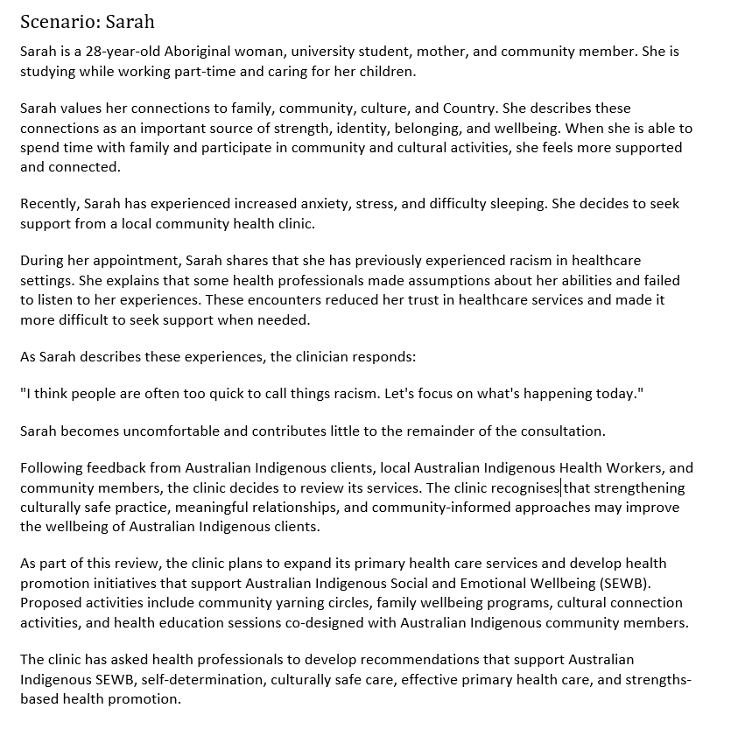
Assessment 2 Scenario

Slide 10
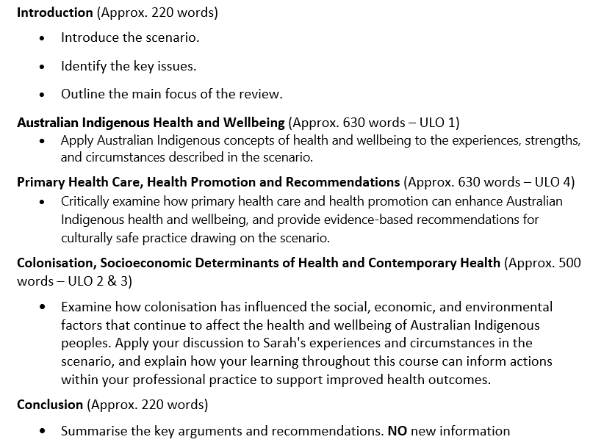
Example Assessment Structure

Slide 11
Your response must …
Assessment Requirements
Be written in a clear, coherent, and respectful academic style.
Support your discussion with evidence from:
  Scholarly literature
  Unit materials
  Definition of Scholarly and Peer-Reviewed sources
  Peer-reviewed sources are academic publications that have been evaluated by experts before publication to ensure quality, accuracy, and credibility. Scholarly sources are written by researchers or experts for an academic audience and include journal articles, academic books, conference papers, and theses. They typically provide author credentials and references. All peer-reviewed sources are scholarly, but not all scholarly sources are peer-reviewed. For example, an academic book may be scholarly without undergoing peer review.
Utilise evidence from a minimum of 12 scholarly sources to support your analysis
Use correct terminology and tone when referring to Australian Indigenous people
Use APA 7th document, referencing, and citation styles in this Unit
Label your submission with your surname and initials, and the assessment task's name, for example:
SmithJ_Critical Review.docx
You MUST add a footer to your submission.
Add your name and task type – i.e. SmithJ_CriticalReview on left margin, your student ID, and have page number on the right margin. See the example below:

Slide 12
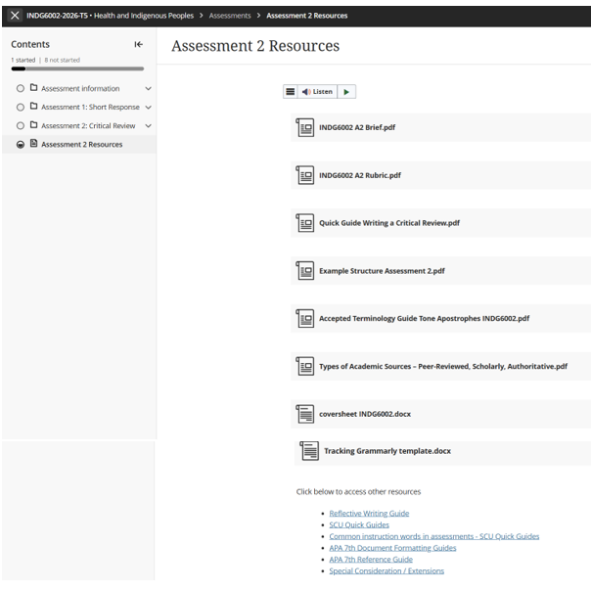
Task Resources & Other Requirements

Slide 13
INDG6002 GenAI Use
In Gnibi College units, the use of GenAI in assessments is generally restricted to protect the integrity and authenticity of the learning process. Indigenous Knowledges are grounded in lived experience, cultural practices, and relational ways of knowing. Engaging meaningfully with these knowledges requires personal reflection, respectful interpretation, and a commitment to culturally responsive learning—something that cannot be authentically achieved through AI-generated content.

Slide 14
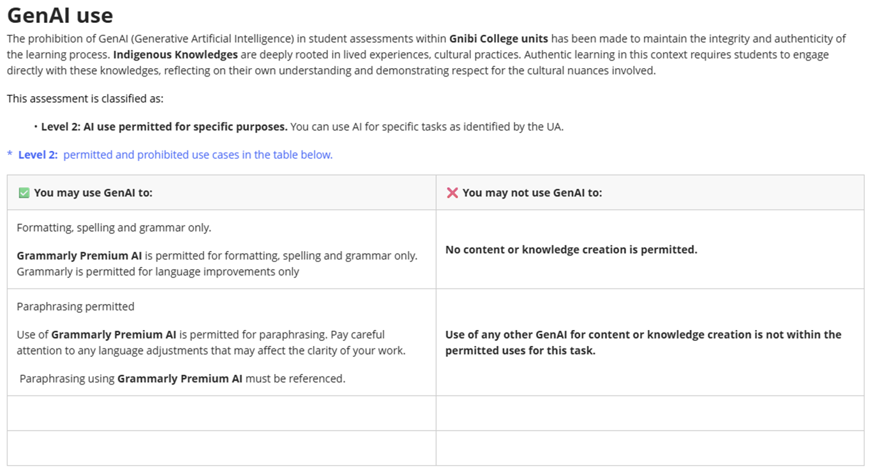
GenAI Use Continued …

Slide 15
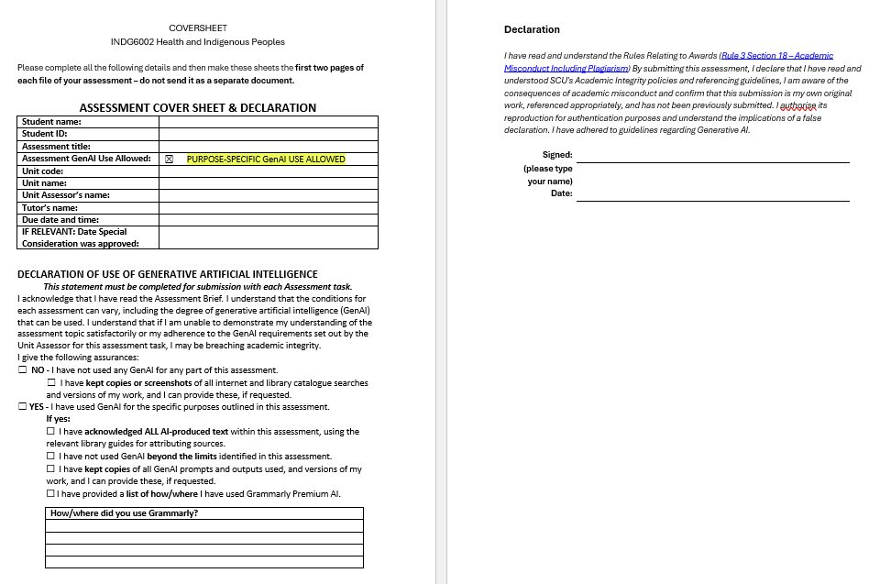
Coversheet & Declaration

Slide 16
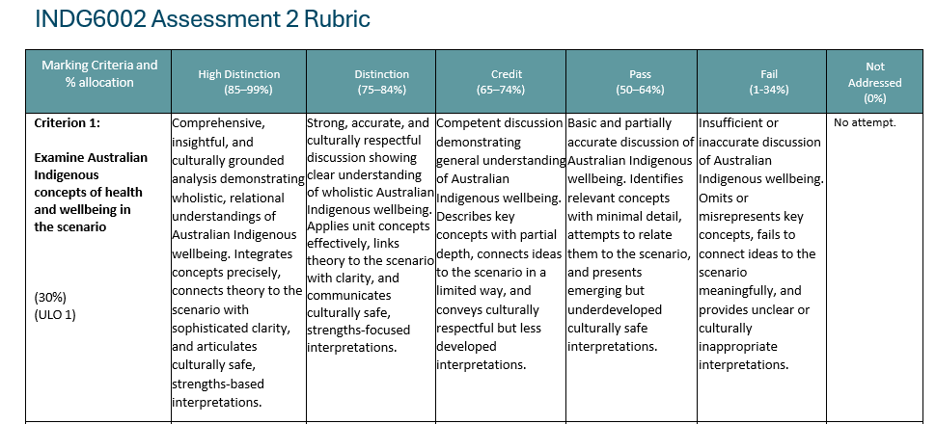
Assessment 2 – Rubric
5 Criteria
1: Examine Australian Indigenous concepts of health and wellbeing in the scenario
2: Analyse the role of Primary Health Care, Health Promotion, and Culturally Safe Recommendations in supporting Australian Indigenous health and wellbeing
3: Critical reflection on how historical contexts have shaped socioeconomic determinants and continue to influence the health and wellbeing of Australian Indigenous peoples
4: Respectful treatment of Australian Indigenous content
5: Academic Communication style, referencing and citation

Slide 17
Questions?

Slide 18
Thank you for participating and sharing in ‘Health and Indigenous Peoples’.
I hope you have enjoyed your learning journey as much as I have enjoyed teaching and learning from your questions and experiences.
I wish you well in your future studies and endeavours.
Ros

